Slide 1

Showing users restaurants based on their location and interests

Slide 2
Introduction
Main problem for people who visit a new place to get restaurants based on their tastes or preferences. Considering their location and interests the results will show a restaurant rating and the ones in the given range. Main purpose of this project is to suggest users’ restaurants depending on the location. Using foursquare website to suggest user restaurants depending on their requirement, there location and the proximity.

Slide 3
Data acquisition:
In this project I used foursquare website data for doing the operations. Once an admin account is created, we will be able to use the credentials to extract the data depending on the need.
Website: https://foursquare.com/city-guide

Slide 4
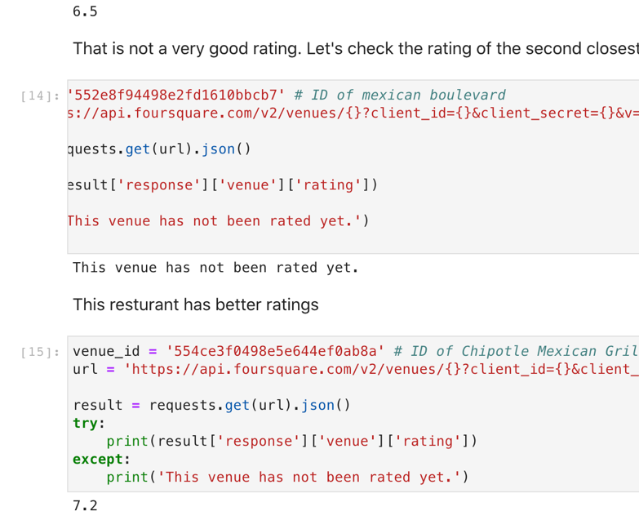
Depending on the results from previous input we can further go ahead and explore the venue to get the ratings of that particular restaurant.

Slide 5
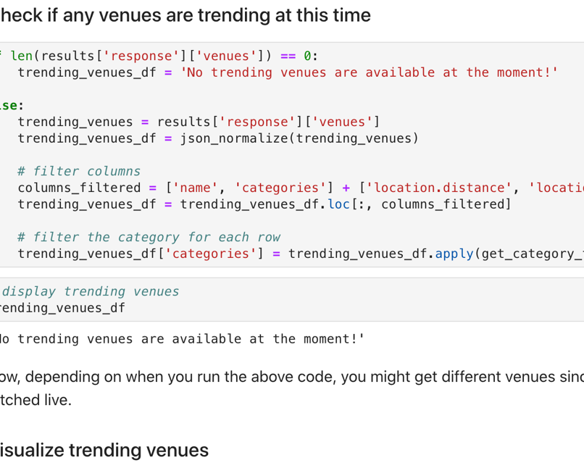
Explore Trending Venues is done to know if there is any very famous or trending place around the user. If there are any the results will be displayed in a map. But as of now there are no trending venues so a map wouldn’t be displayed.

Slide 6

Results:
Results are displayed in a map in the given range depending on the user’s interest and locations. Along with them trending venues data is also displayed.
Conclusion:
While working on the project I understood how to extract data from a website and display it to user. For clear understanding maps are used.

